Slide 1
Union of Professional Coaches
Michal Barda
May 2016

Slide 2
Union of Professional Coaches
Established in 2013 as part of Czech Olympic Committee
110 elite professional coaches from 36 Czech sport federations (incl. many national team coaches)
Founder: Zdeněk Haník
President: Lubor Blažek
Secretary General: Lukáš Kozáček (treneri@olympic.cz)
Driving force: team sports in Czech Republic
Impact: currently ca 20.000 coaches

Slide 3
Vision & Mission
To promote and enhance the competitiveness of Czech sport and its position in international global sport community through:
• building the coaching expertise
education of coach experts of the future
• cooperation with international coaching bodies
• building image of coaching in Czech Republic

Slide 4
Responsibility
Responsibility to increase and enhance the quality of coaching and training process
Responsibility for know-how transfer and sharing
Responsibility for open and transparent information flow and ethics
Responsibility for the development of sport coaching as recognized and respected profession

Slide 5
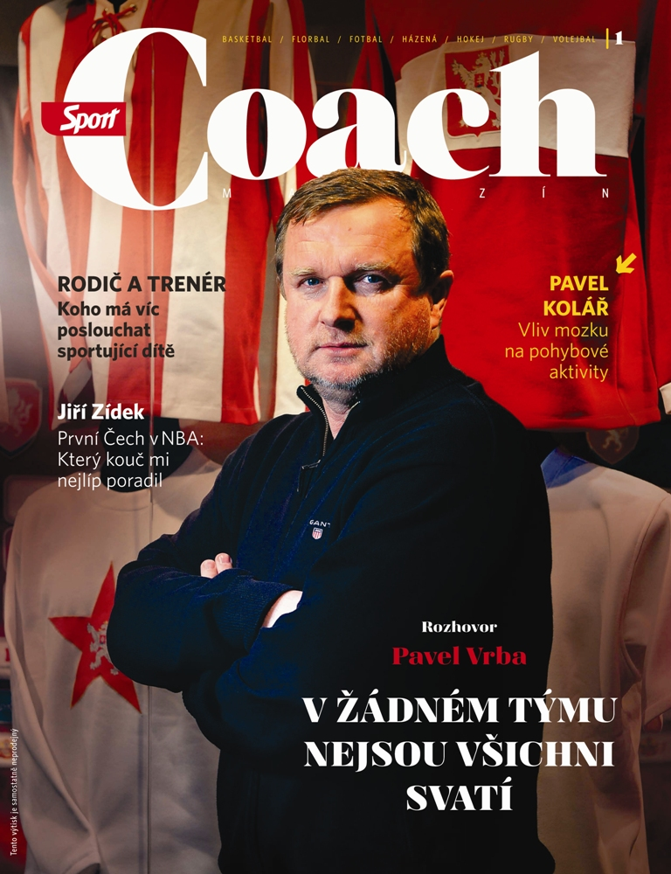
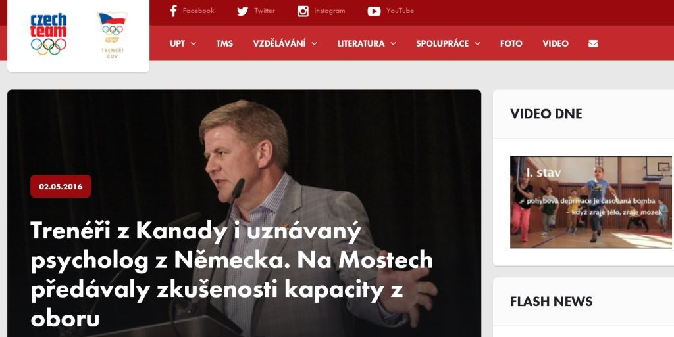
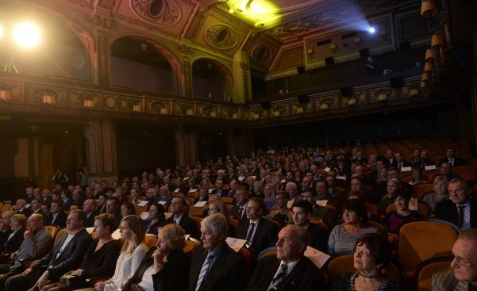
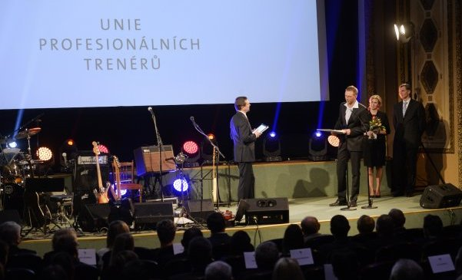
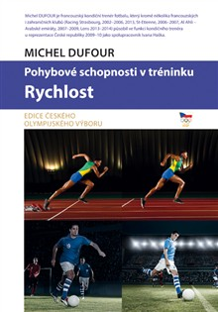
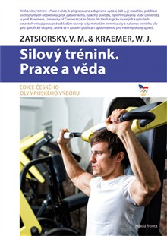
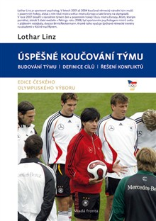
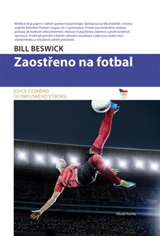

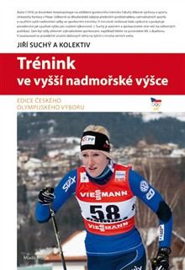
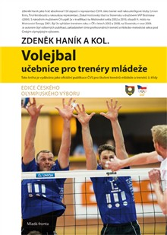
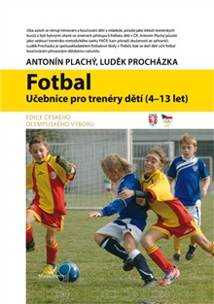
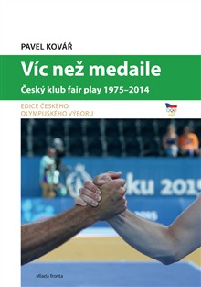
Focus & Activities
1) POPULARIZATION
• specialized book editions for coaches
• „The Coach“ – a quarterly issued magazine as attachment to the most popular „Sport“ daily newspaper
• Video teaser: short trailer promoting the activities of Czech Olympic Academy
Web site with own video channel
„Coach of the Year“ & Hall of Fame Event

Slide 6
Focus & Activities
2) EDUCATION
• „Dialogues“ – interactive lecture series on professional coaching topics (information transfer from top coaches to coaching community)
• Unified coach education programme in team sport games (License B Level)
• Building a skilled and respected lecturer team (incl. most respected experts in Czech Republic)
• Support and help for sport associations in building realistic and functional education models for coaches.

Slide 7
Focus & Activities
3) COOPERATION WITH CZECH INSTITUTIONS
• Cooperation on research projects (e.g. cortisol research)
• Professional cooperation with sport universities
• Cooperation with Czech Kinanthropology Magazine
• United course of action with governmental and non-governmental bodies
• Cooperation with the Association of Sports Psychologists

Slide 8
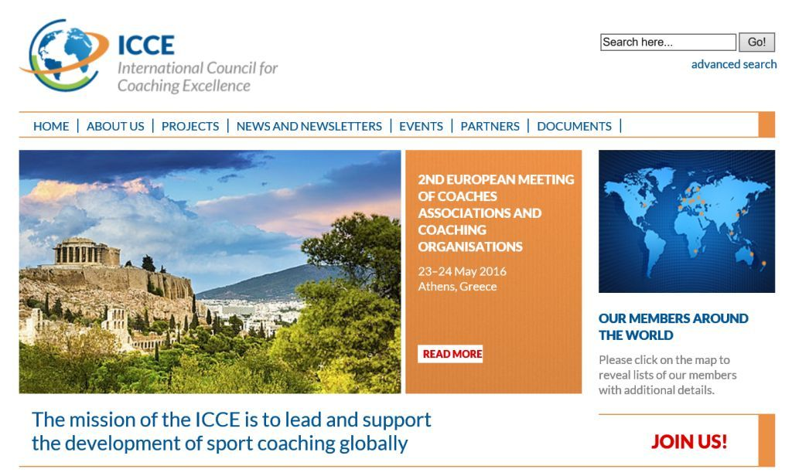
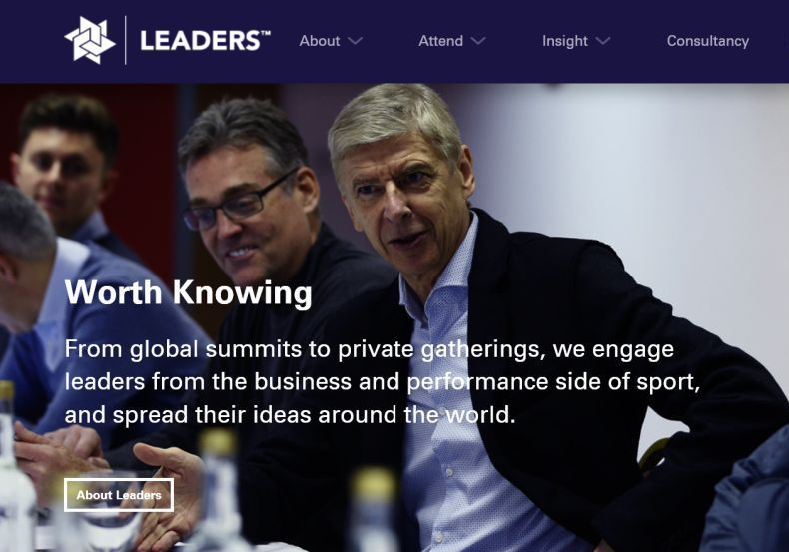
Focus & Activities
4) INTERNATIONAL COOPERATION

Slide 9
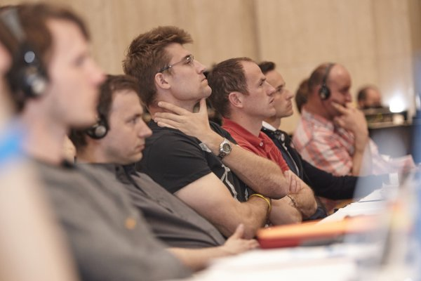
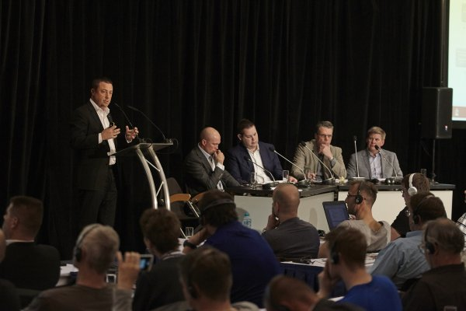
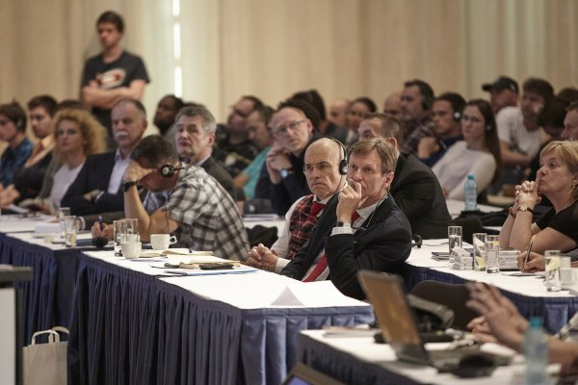
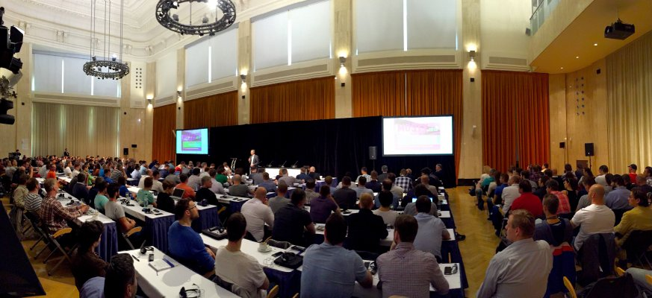
Focus & Activities
5) BRIDGES
• Top international professional coaching conference (BRIDGES between theory and best practice in sports - twice a year, in Prague)

Slide 10


